Slide 1

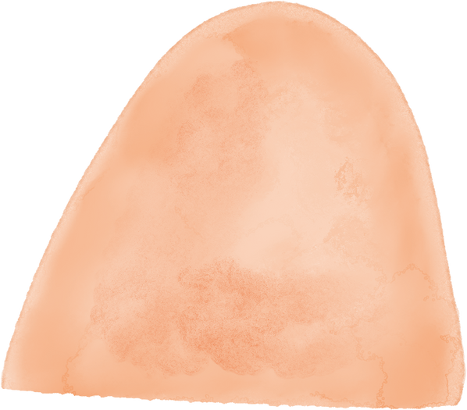





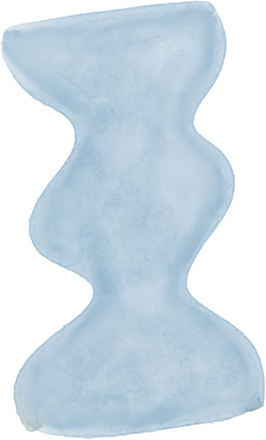



GROUP 1
FACEBOOK FAKE NEWS IN THE POST-TRUTH WORLD
PROFESSOR：李杭 助理教授
reporter：陳怡淋、田郁汝、王莘鎂、吳忠祐、賴姵樺

Slide 2

QUESTION
1.Who is on Facebook?
2.What do people do on Facebook?
3.How has Facebook sustained success?

Slide 3
Q1:
WHO IS ON FACEBOOK?

Slide 4
2004.1
2005
Anyone with a Harvard email address could join and create a profile, which consisted of a photo, biographical information, and some additional personal information.
By the end of February, three quarters of Harvard’s 6,500 undergraduates were registered.
800 colleges and universities were using the site with almost 85% of students at these colleges signed up, and 60% using the site every day.
In September 2005, Zuckerberg opened the site to high schools

Slide 5
2006
2019.6
Facebook's new global cryptocurrency, Libra, enables those without bank accounts to use it.
Facebook was opened to everyone.
( It had 12 million active users)

Slide 6
NOW
Facebook requires users to be at least 13 years old to create an account.
As of the end of 2022, there were up to 3 billion active users, with most users coming from India, Indonesia, and the United States.

Slide 7
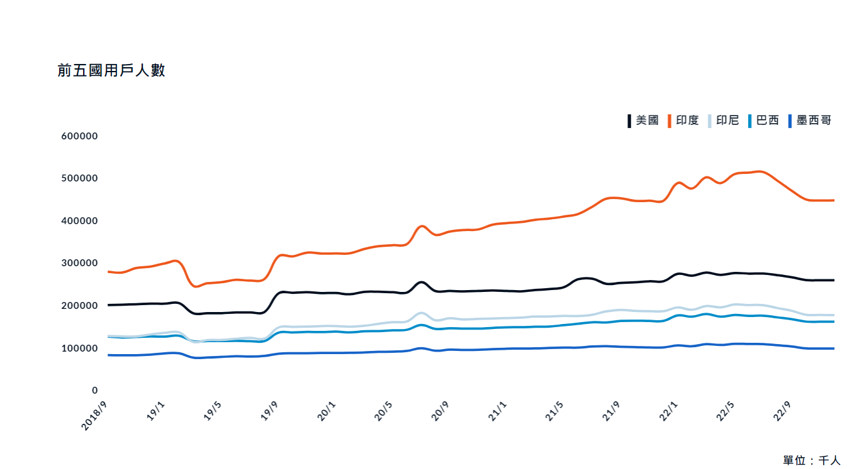
https://zh.oosga.com/facebook-overview/

Slide 8
Q2:
WHAT DO PEOPLE DO ON FACEBOOK?

Slide 9
WHAT CAN PEOPLE DO ON FB?
PERSONAL ENTERTAINMENT
FRIEND INTERACTION
CORPORATE PROMOTION
Enjoy entertaining content, relax, and keep track of what interests you while exploring new interests and information.
People keep in touch with their friends by chatting and interacting with them on Facebook.
Businesses use Facebook to promote their brands, attract potential customers and increase exposure.

Slide 10
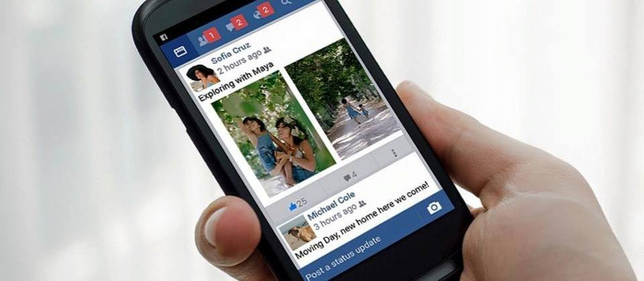
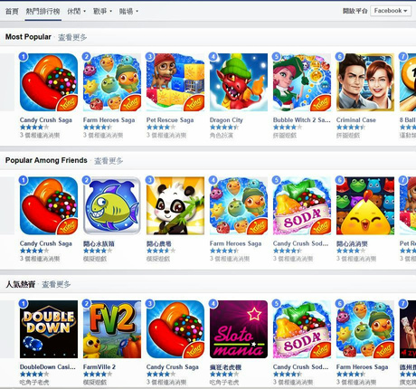
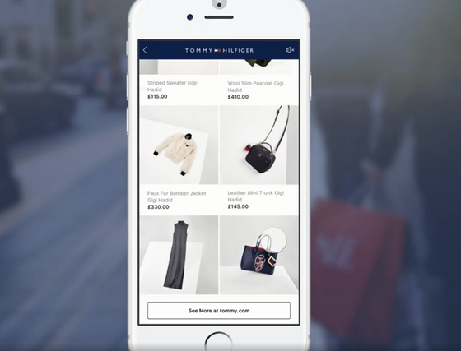
PERSONAL ENTERTAINMENT
KILLING TIME
LINK TO GAME ACCOUNT
ONLINE SHOPPING
Watch funny videos, visit favorite fan page
One-click login
with FB account
Marketplace &
Meta Pay

Slide 11






FRIEND INTERACTION
Post --
shares daily, media publicly
Messenger --
instant messaging and calls
Reels --
short for quick sharing
Group --
communities for interests
Live --
real-time livestream
Like --
Comment on the content

Slide 12
WHAT CAN PEOPLE DO ON FB?
PERSONAL ENTERTAINMENT
FRIEND INTERACTION
CORPORATE PROMOTION
Enjoy entertaining content, relax, and keep track of what interests you while exploring new interests and information.
People keep in touch with their friends by chatting and interacting with them on Facebook.
Businesses use Facebook to promote their brands, attract potential customers and increase exposure.

Slide 13
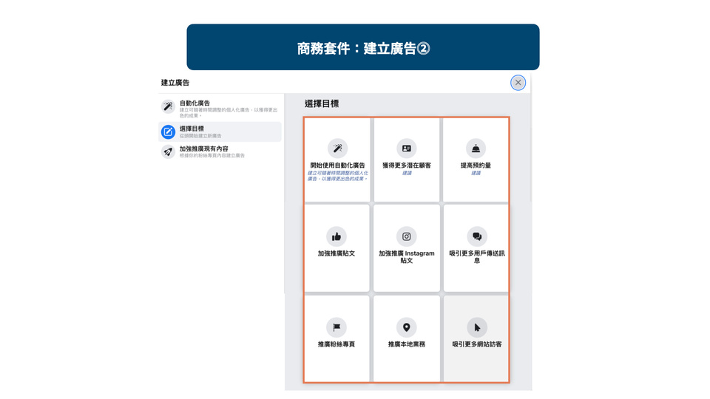
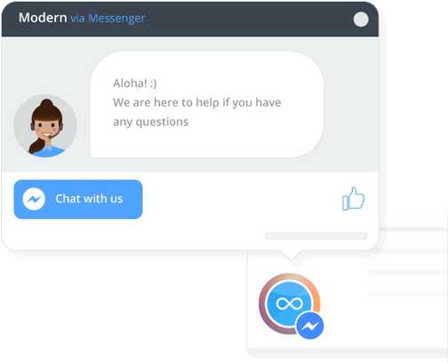
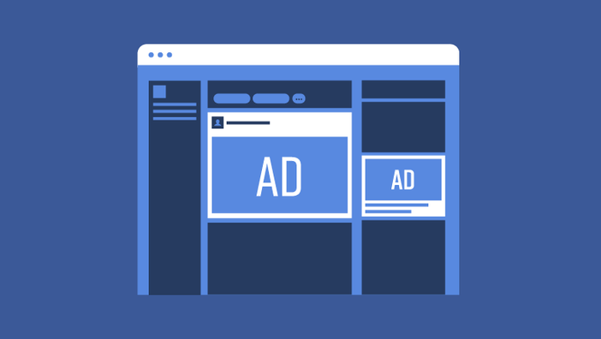
CORPORATE PROMOTION
PLACE INFORMATION
CUSTOMER CONTACT
ADVERTISING
Display business details, products, location etc.
enables direct communication with clients
promotes products to targeted audiences

Slide 14
Q3:
HOW HAS FACEBOOK SUSTAINED SUCCESS?

Slide 15

BEFORE DISCUSSING HOW FB BECAME SUCCESSFUL...
LET’S DISCUSS HOW FB CHANGED THE WORLD IN THESE 20 YEARS
changed the social media game
made our personal data valuable… and less personal
made the internet political
kick-started Meta's dominance

Slide 16
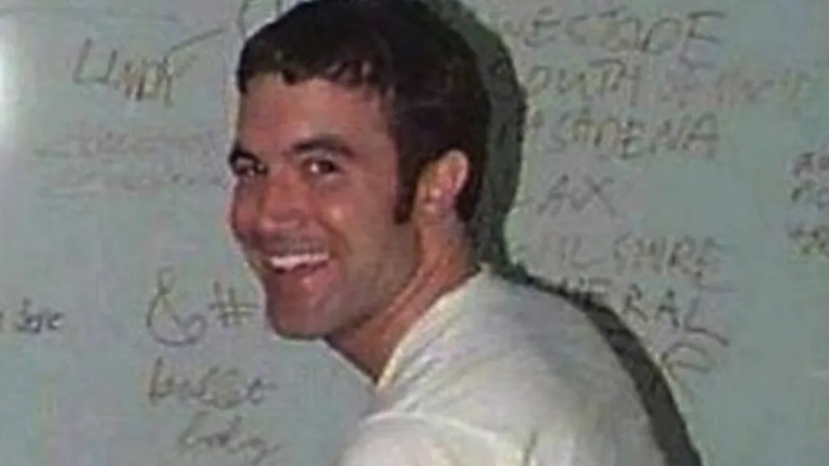
CHANGED THE SOCIAL MEDIA GAME
Other social networks(MySpace), existed before Facebook - but Mark Zuckerberg's site instantly took off when it launched in 2004
In less than a year it had one million users, and within four years it had overtaken MySpace - fuelled by innovations such as the ability to "tag" people in photos.
Taking a digital camera on a night out, then tagging your friends in dozens of pictures was a staple of teenage life in the late noughties

Slide 17
FACEBOOK MADE OUR PERSONAL DATA VALUABLE… AND LESS PERSONAL
Facebook's parent company Meta is an advertising giant which, alongside the likes of Google, takes the lion's share of global advertising money
Meta reported more than $40bn (£32bn) in revenue for the last quarter of 2023, chiefly from offering advertisers highly targeted ad services
Facebook proved that collecting our likes and dislikes is extremely lucrative.

Slide 18
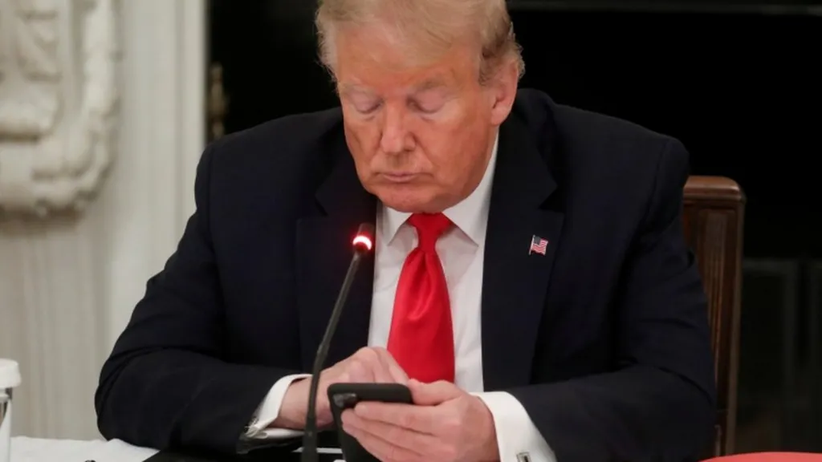
FACEBOOK MADE THE INTERNET POLITICAL
according to Statista research, in the five months leading up to the US presidential election of 2020, incumbent President Donald Trump's team spent more than $40m on Facebook adverts

Slide 19
FACEBOOK KICK-STARTED META'S DOMINANCE
01
02
03
With the huge success of Facebook, Mark Zuckerberg built a social network and technology empire that remains unprecedented in terms of users and its consequent power.
Up-and-coming companies, including WhatsApp, Instagram and Oculus, were all purchased and turbo-charged under the umbrella company Facebook, which changed its name to Meta in 2021.
Meta now says more than three billion people use at least one of its products every day.

Slide 20
FACEBOOK KICK-STARTED META'S DOMINANCE
04
05
Facebook and Instagram's disappearing Stories feature is similar to a key feature found on Snapchat; Instagram Reels is the company's answer to the challenge posed by video-sharing app TikTok; and Threads is Meta's attempt to imitate X, formerly known as Twitter.
Facebook buys Instagram for $1bn
Facebook to buy WhatsApp for $19bn
Facebook buys virtual reality firm Oculus for $2bn

Slide 21


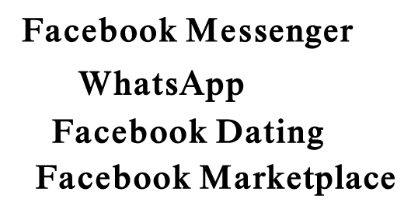

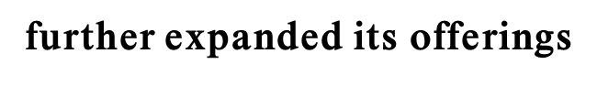



HOW HAS FACEBOOK SUSTAINED SUCCESS?
Constant Innovation and Expansion
Network Effects
Continually evolved, adding new features
where its large user base made the platform increasingly valuable for both users and advertisers. This created a powerful feedback loop, ensuring more users and advertisers gravitated toward Facebook
Acquiring other successful startups

Slide 22
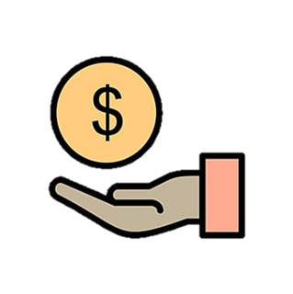
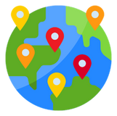



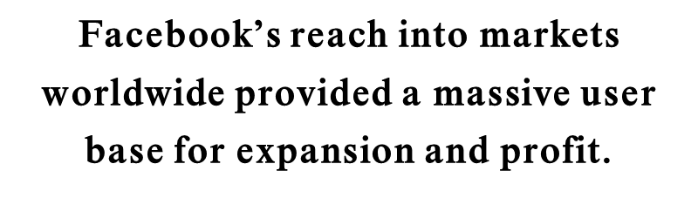



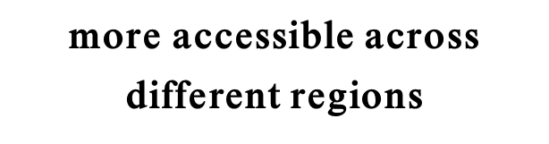
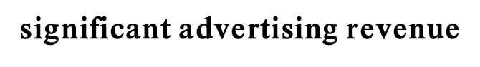
HOW HAS FACEBOOK SUSTAINED SUCCESS?
Developed a robust advertising model,

Slide 23
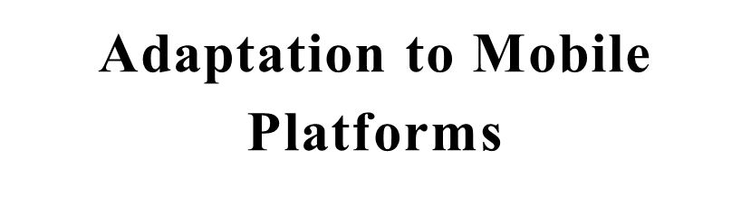
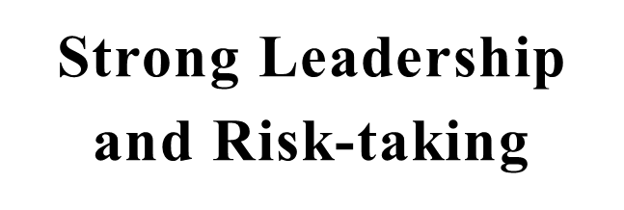
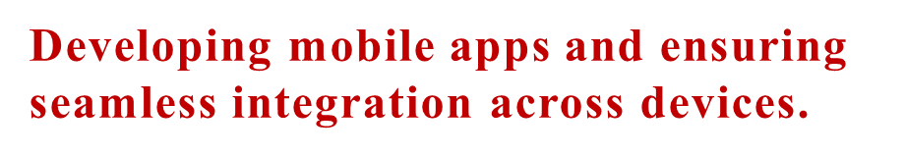
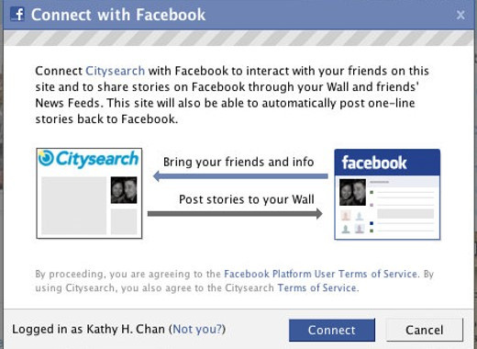
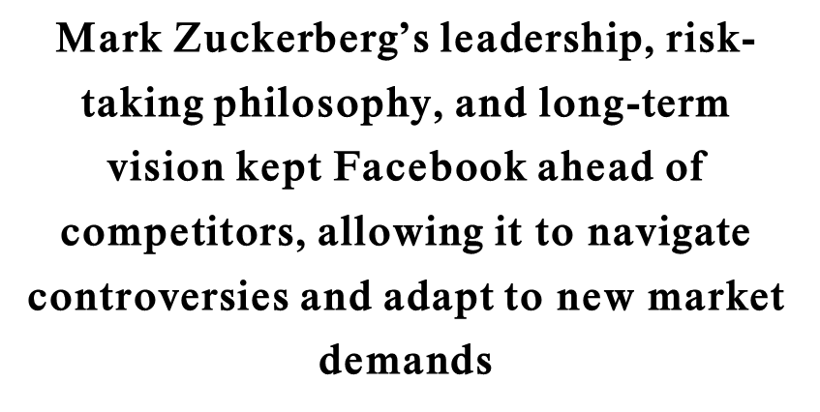
HOW HAS FACEBOOK SUSTAINED SUCCESS?

Slide 24

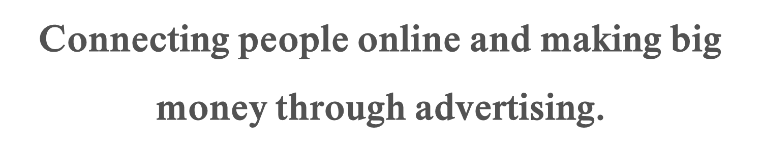
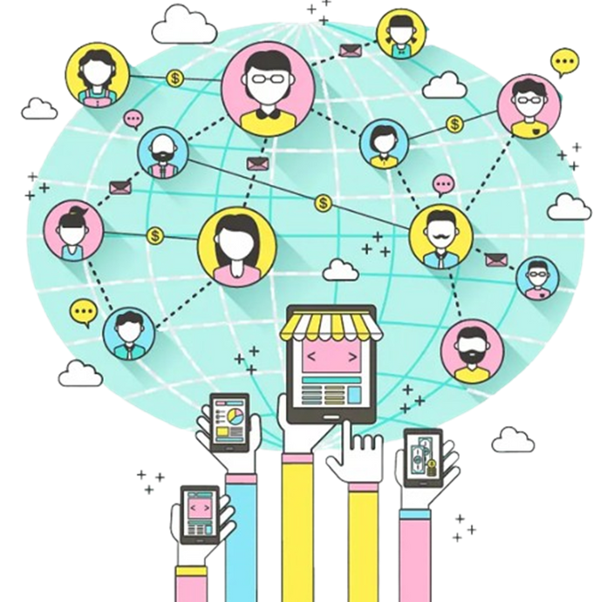

Slide 25
THANK FOR LISTENING!

